Slide 1


SENTIMENTPULSE
LIVE
By Team Spirit

Slide 2
TABLE OF CONTENTS
01
05
02
06
03
07
04
08
Team Member Roles and Responsibilities
Personas
Improvements
MVP
Project Description
Technologies
Team Working Agreement
Algorithms

Slide 3
TABLE OF CONTENTS
09
13
10
14
11
15
12
Diagrams & Sprint 1 Recap
Retrospective
Product Backlog
Project Demo
Sprint 3 Backlog
WikiPage Link and Live Demo
Metrics

Slide 4



Team Member Roles and Responsibilities
Sandhya Reddy Kallem
Yashwanth Thalla
Dhruv Maheshbhai Ranpariya
Frontend developer
Backend Developer
Frontend Developer

Slide 5


Team Member Roles and Responsibilities
Hema Durga Prasad Chittala
Sravan Kumar Ganji
Backend Developer
Machine Learning Enginner

Slide 6
Improvements
Adding so that
Changing from points to numbers.

Slide 7
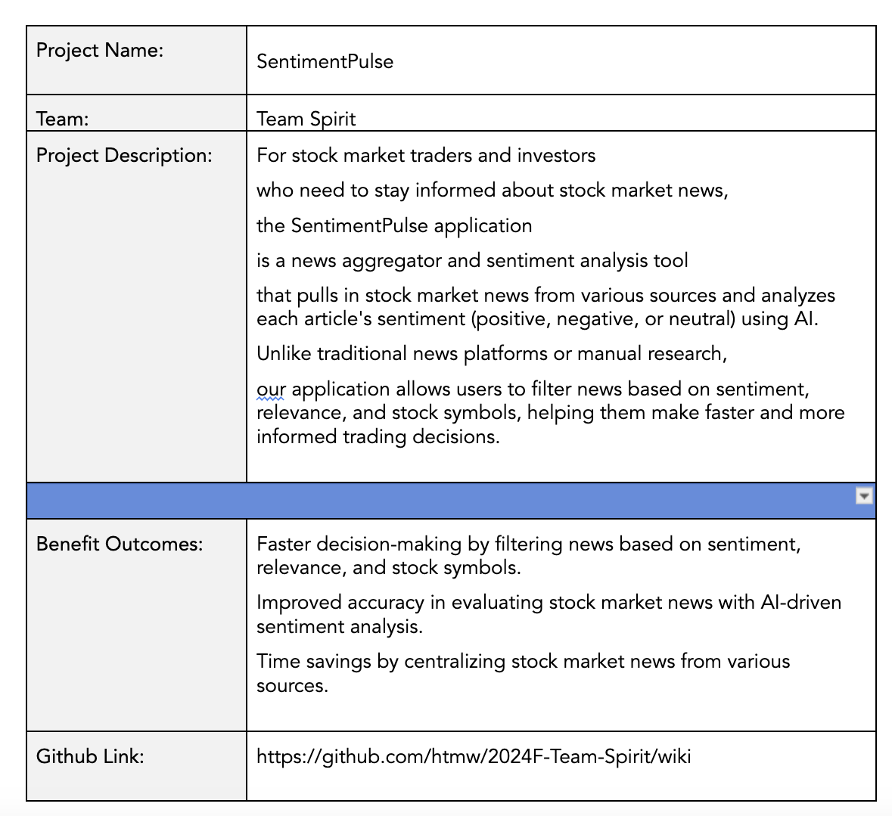
Project Description

Slide 8
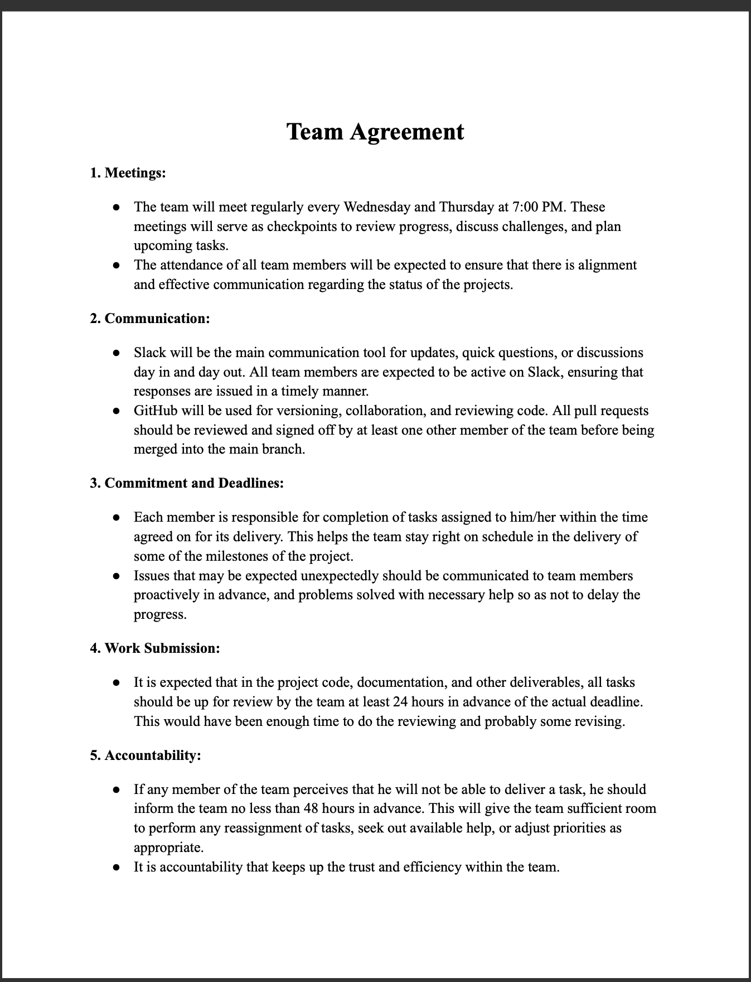
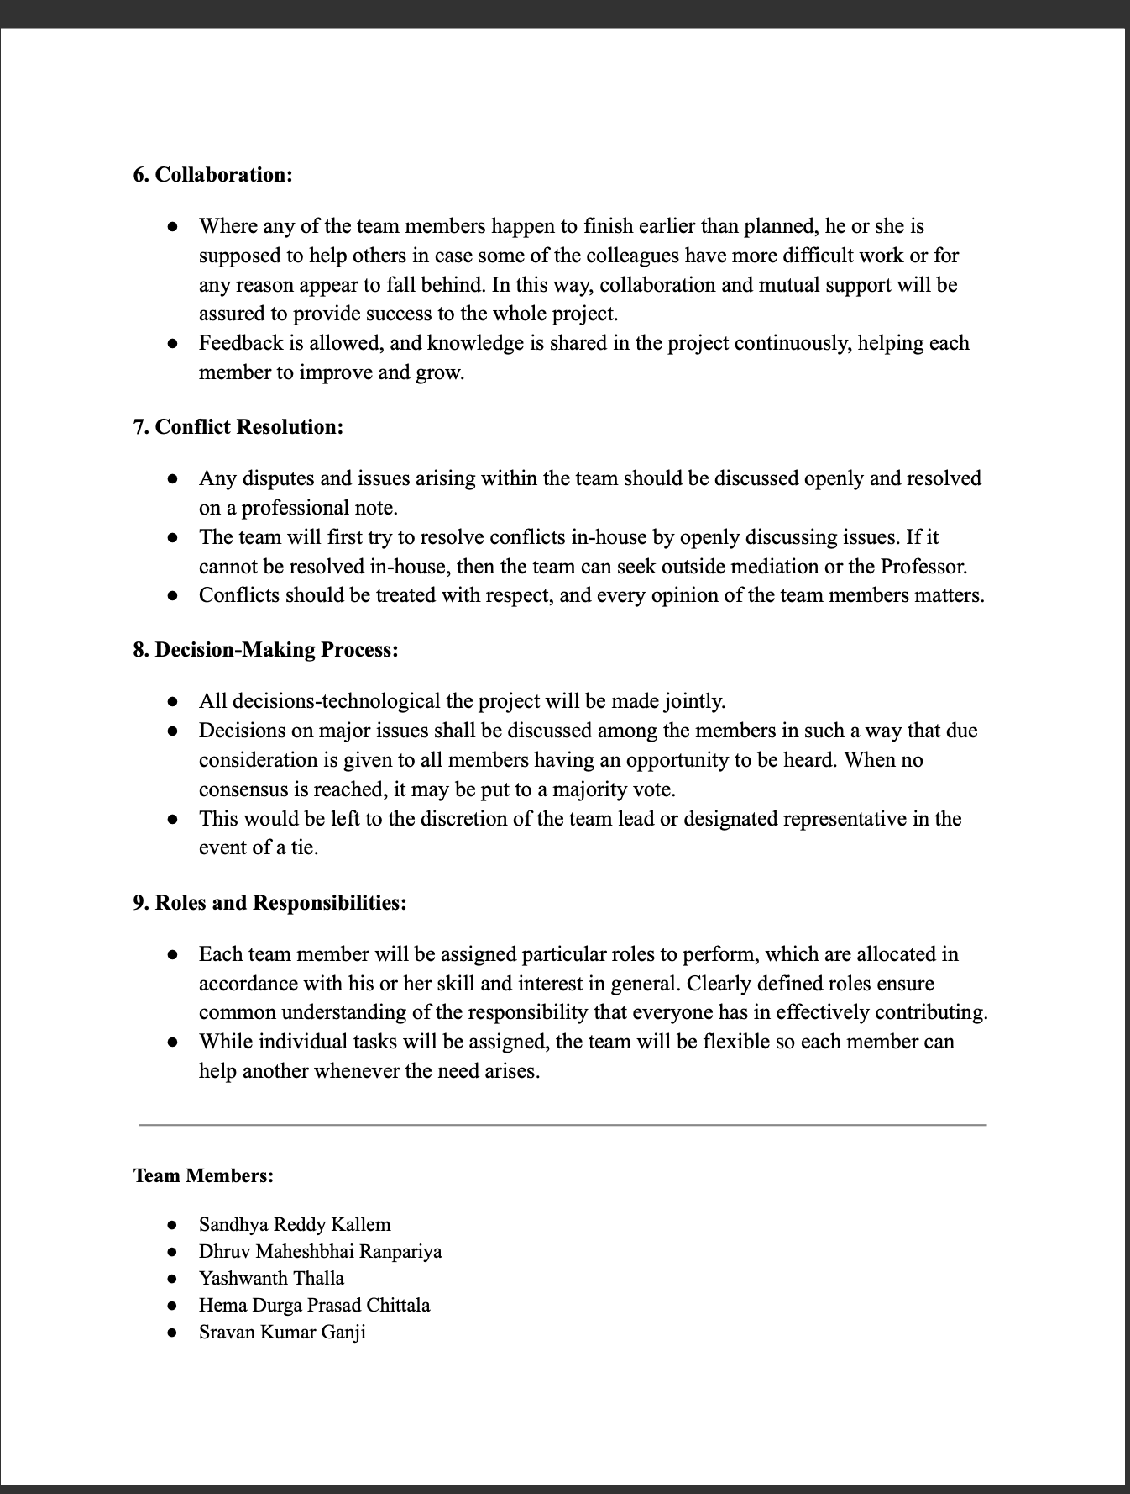
Team Agreement

Slide 9

Rajesh Verma (India)
Age: 35
Occupation: Software Engineer
Experience with Investing: 5 years
Location: Bengaluru, India
Investment Strategy: Focuses on Indian stocks with occasional investments in U.S. tech stocks. Primarily uses fundamental analysis and financial news.
Challenges: Rajesh’s demanding job leaves him with limited time to monitor markets, especially given his tech-heavy portfolio. He’s overwhelmed by the volume of news and struggles to quickly filter relevant insights, often missing timely opportunities.
Goal: To make faster, data-driven stock decisions using an AI tool that highlights relevant updates and fits his busy schedule.

Slide 10

Elsa Thompson (United States)
Age: 28
Occupation: Financial Analyst
Experience with Investing: 7 years
Location: New York, USA
Investment Strategy: Tracks energy and healthcare sectors, relying on research and sentiment data.
Challenges: Sorting through large volumes of news delays Elsa, leading to occasional missed insights. She finds it difficult to quickly identify sector-specific news that could impact her recommendations.
Goal: To improve her efficiency by using AI to prioritize critical news in her sectors, enabling more timely, insightful recommendations.

Slide 11

Lucas Müller (Germany, Europe)
Age: 45
Occupation: Independent Investor & Trader
Experience with Investing: 15 years
Location: Munich, Germany
Investment Strategy: Trades European and U.S. stocks, relying on global news.
Challenges: The global scope of his portfolio requires Lucas to keep up with a vast range of international events. He wants to reduce emotional trading and leverage AI-driven sentiment analysis to make quicker, objective decisions.
Goal: To use AI to filter impactful global news and provide sentiment insights, helping him trade more confidently and objectively.

Slide 12
Minimum Viable Product
News Aggregation Fetch and display financial news articles from reputable sources through APIs.
Sentiment Analysis Analyze the sentiment of each news article (positive, neutral, negative) using a sentiment analysis tool.
Company Mention Detection Identify and highlight companies referenced in the news articles.
User Interface Present the news articles, sentiment scores, and impacted companies in a clean, intuitive interface.

Slide 13
Technologies
Backend
Frontend
Database
Flask, Express JS
ReactJS
MongoDB
Machine Learning
API
Cloud Hosting
PyTorch, Huggingface
NewsAPI
GCP

Slide 14


Backend
What is it?
How is it used?
Flask is a lightweight Python web framework, and Express JS is a fast and minimalist web framework for Node.js.
Flask or Express JS will be used to handle backend logic, manage API requests, and serve data between the frontend and the database, enabling communication between the sentiment analysis AI and the stock market news aggregator.

Slide 15

Frontend
What is it?
How is it used?
ReactJS is a popular JavaScript library for building interactive user interfaces.
ReactJS will be used to build the web application's dynamic and responsive frontend, allowing users to interact with the platform, view stock market news, and access AI-driven sentiment insights.

Slide 16

DATABASE
What is it?
How is it used?
MongoDB is a NoSQL database designed for flexibility and scalability, storing data in JSON-like documents.
MongoDB will store news articles, user preferences, and AI-generated sentiment analysis, enabling fast retrieval and updates as new data comes in from the API.

Slide 17

Machine learning
What is it?
How is it used?
PyTorch is a machine learning framework, and Huggingface is a platform that provides pre-trained models and tools for NLP tasks.
PyTorch and Huggingface will be used to develop and deploy sentiment analysis models that process stock market news and classify the sentiment of each article (positive, neutral, or negative).

Slide 18
API
What is it?
How is it used?
NewsAPI is a service that provides access to news articles from various sources around the world.
NewsAPI will be integrated into the backend to pull relevant stock market news articles, which will be processed by the sentiment analysis model before being displayed to users.

Slide 19

Cloud Hosting
What is it?
How is it used?
Google Cloud Platform is a suite of cloud computing services that provides infrastructure for hosting applications.
GCP will host the web application, manage the backend servers, store data, and provide the resources necessary for running the machine learning models and API integrations efficiently.

Slide 20
Algorithm
What is BERT?
In what way is it applied?
BERT is an advanced Natural Language Processing (NLP) model developed by Google. It is formulated on the Transformer architecture and is devised to comprehend the context of a word in a sentence by studying it in both directions—left and right from the word—thus, it is very useful for sentiment analysis tasks, for example, understanding the sentiment of the text.
In the context of your project, BERT can be utilized through Huggingface to analyze stock market news articles and perform sentiment analysis. It will monitor the text and determine the sentiment(s) expressed in the news as positive, neutral, or negative. Therefore the technology enabling the categorization of each news piece and, consequently the provision of sentiment insights to the investors that quick assess of how the news may impact the stock performance. BERT's success in learning complex language patterns makes sentiment analysis more precise, which gives a more well-founded recommendation compared to the traditional NLP models.

Slide 21
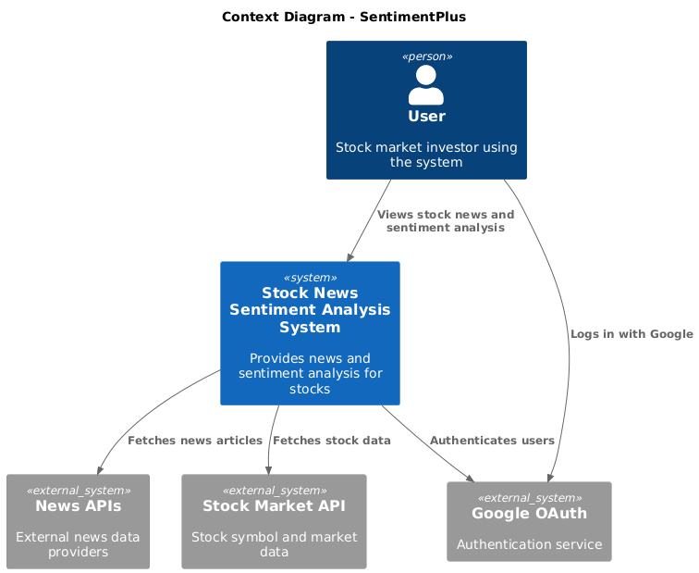
Context Diagram

Slide 22
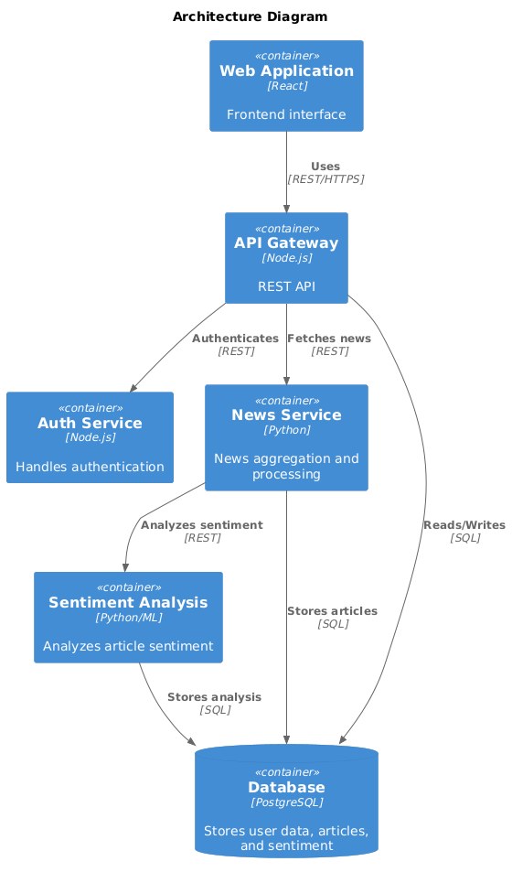
Architecture Diagram

Slide 23
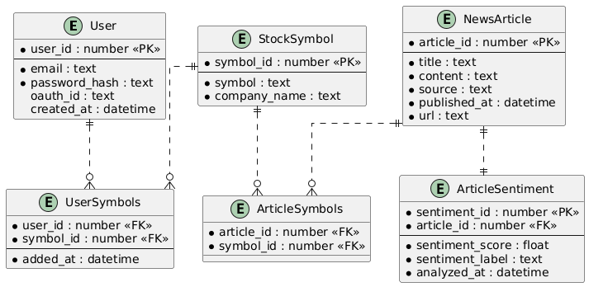
ER Diagram

Slide 24
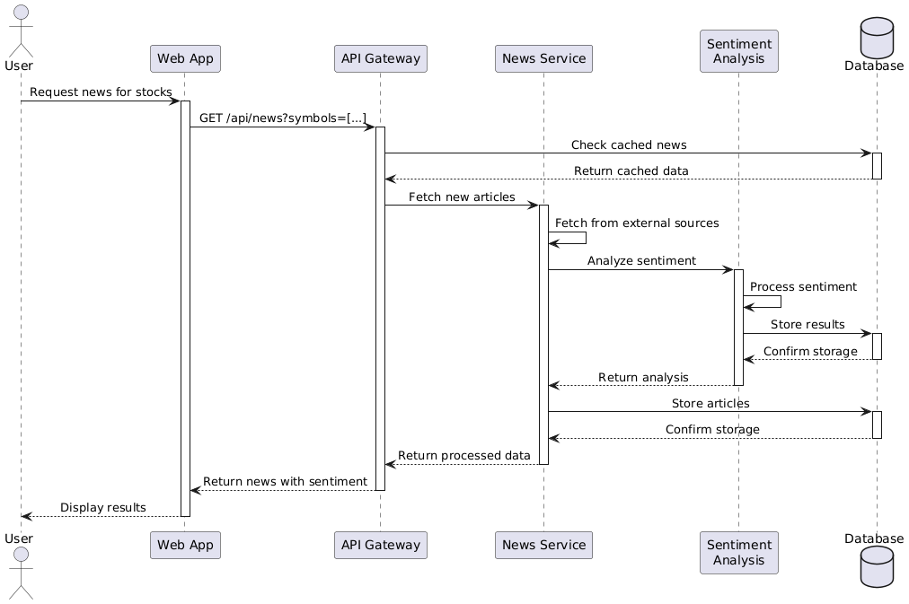
Sequence Diagram

Slide 25
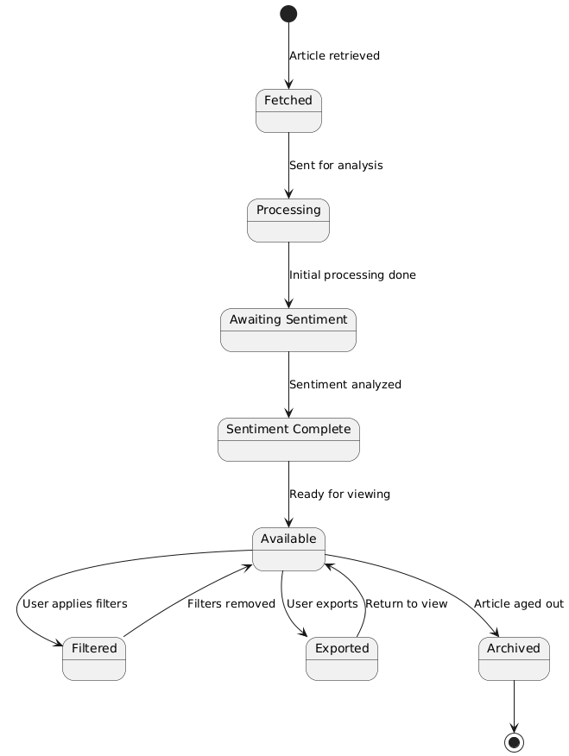
State Diagram

Slide 26
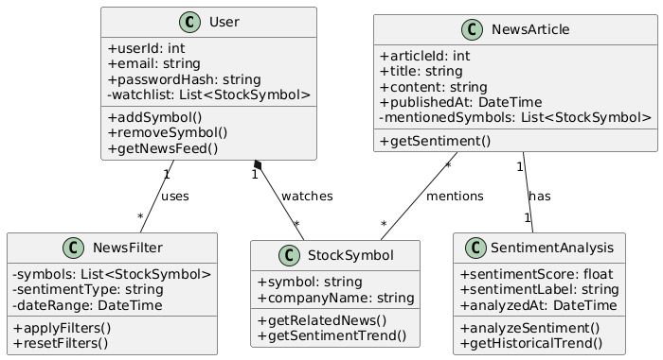
Class Diagram

Slide 27
Product Backlog
ID | Description | Acceptance Criteria | Feature | Story Points
US1 | As an investor, I want to input stock symbols of interest so that I can receive relevant news articles. | Users can search and input stock symbols. Stock symbols stored and shown on dashboard. | Stock Symbols | 5
US2 | As an investor, I want to view a list of news articles related to the stock symbols I've selected so that I can stay informed about relevant updates. | Articles are filtered by stock symbols. News displayed in chronological order. | News Feed | 8
US3 | As an investor, I want to filter news articles by relevance to my stock symbols so that I can focus on the most important articles. | News ranked by relevance to stock symbols. Filter option for relevant articles only. | News Relevance Filter | 5
TT1 | Backend developer sets up infrastructure for news aggregation and stock symbol search functionality so that the system can fetch and manage news efficiently. | API fetches news from 3 sources. Backend handles stock searches and storage. | Backend Infrastructure | 8
TT2 | Database administrator establishes database structure for managing user profiles, stock symbols, and news articles so that user data and preferences are stored effectively. | Create tables for users, symbols, articles. Ensure user-stock preferences are linked. | Database Setup | 5

Slide 28
Product Backlog
ID | Description | Acceptance Criteria | Feature | Story Points
US4 | As an investor, I want to log in securely so that I can access personalized sentiment analysis features. | Users log in with email/password. Support Google OAuth login. | Authentication | 8
US5 | As an investor, I want each news article to display a sentiment rating (positive) so that I can gauge its emotional tone. | Sentiment rating visible for each article. Sentiment rating is easy to understand. | Sentiment Analysis | 5
US6 | As an investor, I want each news article to display a sentiment rating (negative) so that I can gauge its emotional tone. | Sentiment rating visible for each article. Sentiment rating is easy to understand. | Sentiment Analysis | 5
US7 | As an investor, I want each news article to display a sentiment rating (neutral) so that I can gauge its emotional tone accurately. | Sentiment rating visible for each article. Sentiment rating is easy to understand. | Sentiment Analysis | 5
US8 | As an investor, I want to filter news articles by sentiment type so that I can focus on specific tones (e.g., positive news). | Filter by positive, negative, neutral. Dynamic UI update when filtering. | Sentiment Filter | 5

Slide 29
Product Backlog
ID | Description | Acceptance Criteria | Feature | Story Points
TT3 | Developer integrates AI sentiment analysis engine for news articles so that sentiment can be assigned to each article accurately. | AI assigns sentiment to articles. AI achieves 80% accuracy or higher. | Sentiment Analysis Engine | 8
TT4 | Developer implements user authentication system (login and OAuth) so that users can securely access their accounts. | Implement login with email/password. Add OAuth for social logins. | Authentication | 13
TT5 | Developer connects backend to sentiment analysis model so that sentiment data is processed in real time. | API connects backend to sentiment model. Ensure real-time sentiment processing. | Backend Integration | 3
US9 | As an investor, I want to filter articles based on both stock symbols and sentiment so that I can focus on the best insights for my trading decisions. | Apply filters for symbols and sentiment. Filtered news updates in real time. | Combined Filtering | 5
US10 | As an investor, I want to export sentiment analysis and news data to a CSV file so that I can analyze it offline. | Provide option to export data to CSV. Export includes stock, sentiment, and news. | Data Export | 3

Slide 30
Product Backlog
ID | Description | Acceptance Criteria | Feature | Story Points
US11 | As an investor, I want to view historical sentiment trends for a particular stock symbol so that I can analyze long-term market sentiment. | Sentiment trends shown graphically. View trends for different time periods. | Historical Trends | 8
US12 | As an investor, I want to reset all filters easily so that I can return to the full, unfiltered news feed. | Provide a clear option to reset filters. Reset clears all active filters. | Filter Reset | 2
TT6 | Developer implements historical sentiment tracking and visualization so that users can view sentiment trends over time. | Track and store historical sentiment. Display trends using a graph. | Historical Sentiment Graph | 8
TT7 | Developer improves frontend performance and responsiveness so that users have a smooth and efficient experience on both mobile and desktop. | Optimize UI for mobile and desktop. Ensure fast filter application. | Frontend Optimization | 5

Slide 31
Sprint 3 Backlog
ID | Description | Acceptance Criteria | Feature | Story Points
US9 | As an investor, I want to filter articles based on both stock symbols and sentiment so that I can focus on the best insights for my trading decisions. | Apply filters for symbols and sentiment. Filtered news updates in real time. | Combined Filtering | 5
US10 | As an investor, I want to export sentiment analysis and news data to a CSV file so that I can analyze it offline. | Provide option to export data to CSV. Export includes stock, sentiment, and news. | Data Export | 3
US11 | As an investor, I want to view historical sentiment trends for a particular stock symbol so that I can analyze long-term market sentiment. | Sentiment trends shown graphically. View trends for different time periods. | Historical Trends | 8
US12 | As an investor, I want to reset all filters easily so that I can return to the full, unfiltered news feed. | Provide a clear option to reset filters. Reset clears all active filters. | Filter Reset | 2
TT6 | Developer implements historical sentiment tracking and visualization so that users can view sentiment trends over time. | Track and store historical sentiment. Display trends using a graph. | Historical Sentiment Graph | 8

Slide 32
Sprint 3 Backlog
ID | Description | Acceptance Criteria | Feature | Story Points
TT7 | Developer improves frontend performance and responsiveness so that users have a smooth and efficient experience on both mobile and desktop. | Optimize UI for mobile and desktop. Ensure fast filter application. | Frontend Optimization | 5

Slide 33
Test Cases
Test Case ID | ID | Test Case Description | Expected Result | Actual Result | Pass/Fail
TC1 | US9 | Verify filtering articles by stock symbols and sentiment. | Articles are filtered based on selected stock symbols and sentiment. | Matches expected | Pass
TC2 | US9 | Verify real-time update of filtered news. | Filtered news updates are displayed in real time without delay. | Matches expected | Pass
TC3 | US10 | Verify option to export data to CSV. | Export functionality is available, and CSV includes stock, sentiment, and news details. | Matches expected | Pass
TC4 | US11 | Verify historical sentiment trends visualization. | Graph displays sentiment trends for selected stock and different time periods. | Matches expected | Pass
TC5 | US12 | Verify option to reset all filters. | Filters are reset, and the full news feed is displayed. | Matches expected | Pass
TC6 | TT6 | Verify historical sentiment data tracking and graph. | Historical sentiment data is stored correctly and displayed in the graph. | Matches expected | Pass
TC7 | TT7 | Verify frontend responsiveness and performance. | UI is responsive for mobile/desktop, and filters are applied quickly. | Matches expected | Pass

Slide 34
Stories Completed
ID | Feature | Description | Test Case IDs | Story Points
US9 | Combined Filtering | Allows filtering of articles based on stock symbols and sentiment. | TC1, TC2 | 5
US10 | Data Export | Provides the option to export news and sentiment analysis to a CSV file. | TC3 | 3
US11 | Historical Trends | Displays historical sentiment trends for selected stock symbols. | TC4 | 8
US12 | Filter Reset | Allows users to reset all filters and view the full news feed. | TC5 | 2
TT6 | Historical Sentiment Graph | Tracks and visualizes historical sentiment data for stock symbols. | TC6 | 8
TT7 | Frontend Optimization | Enhances frontend responsiveness and filter performance. | TC7 | 5

Slide 35
Team Velocity - This Sprint
Total Story Points Completed: 31 points

Slide 36
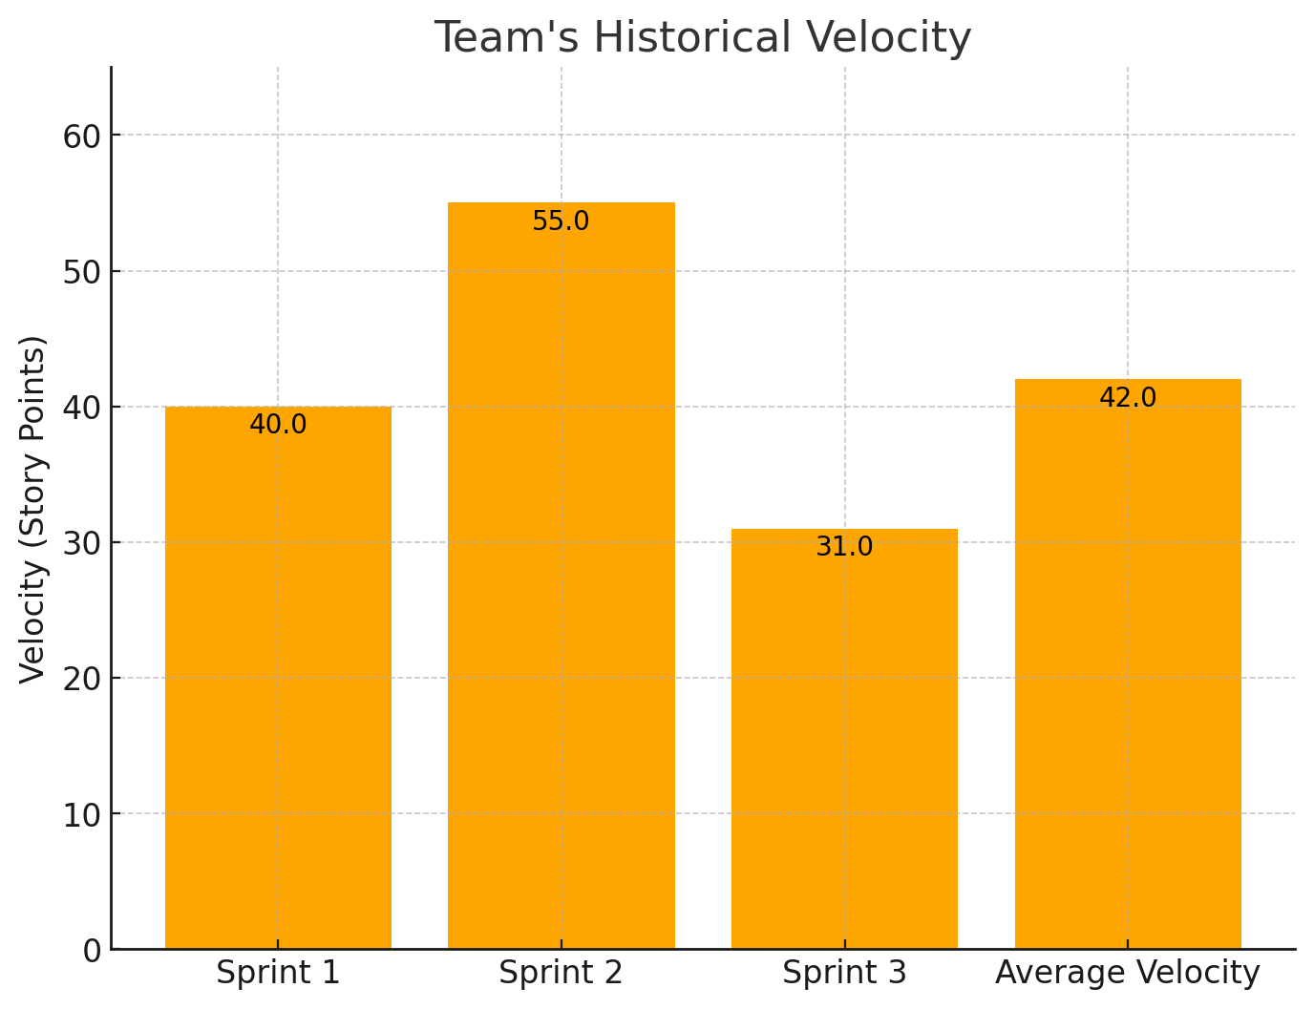
Team's historical velocity (average)

Slide 37
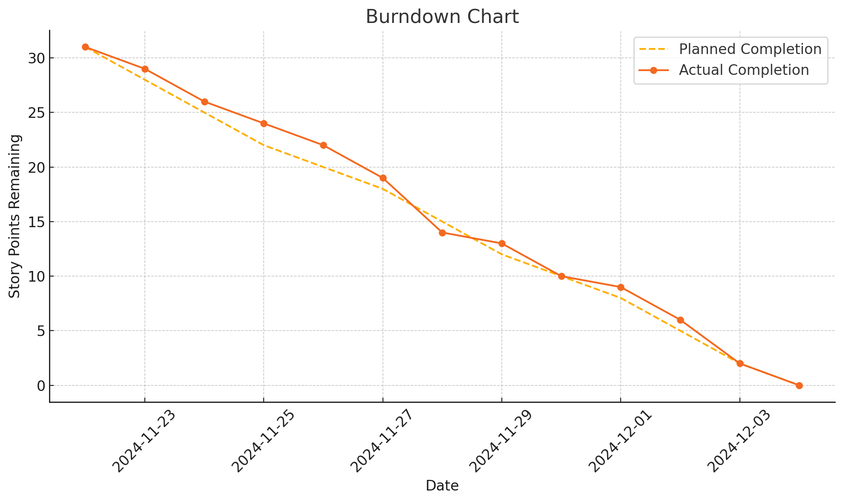
Burndown Chart

Slide 38
Completed/Committed Ratio
Completed Story Points: 31
Committed Story Points: 31
So, the ratio is:
31/31=100%

Slide 39
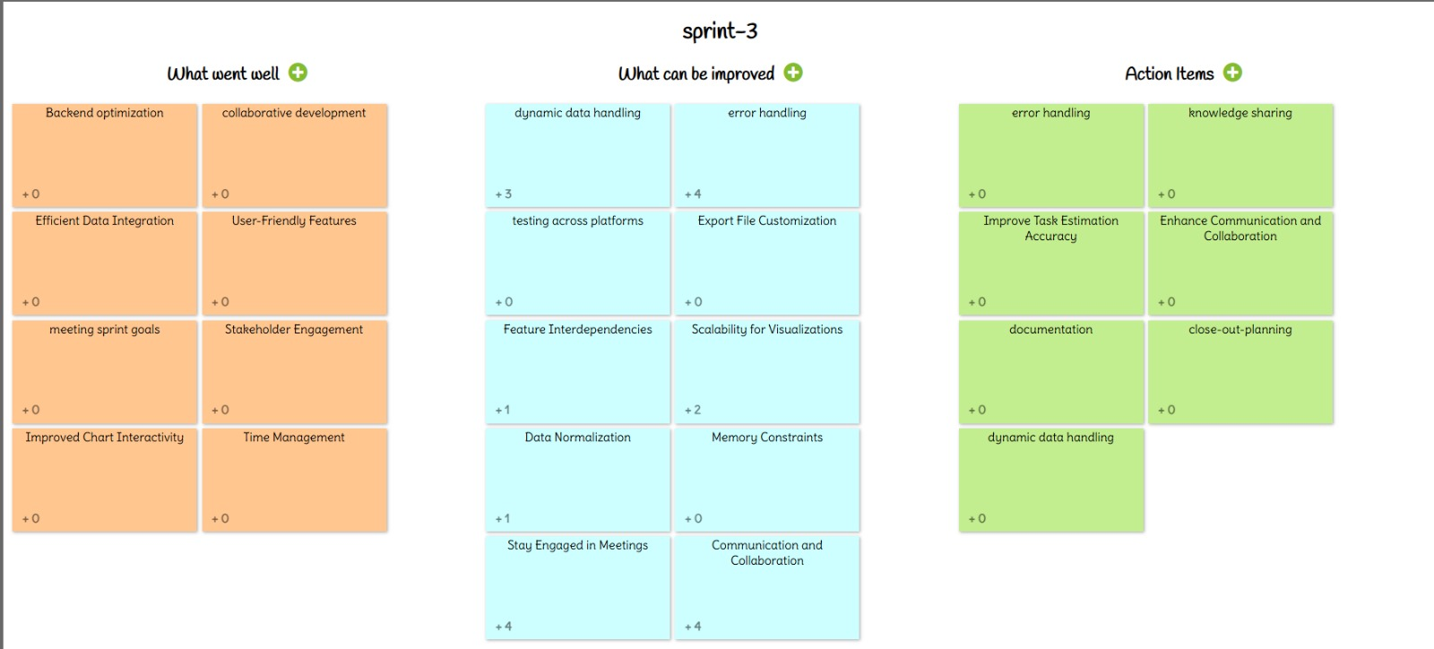
Retrospective

Slide 40
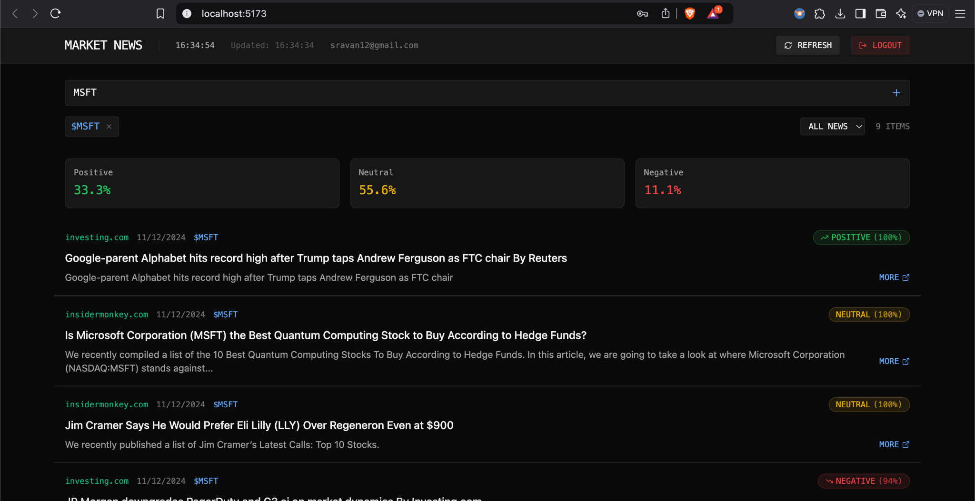
App Screenshot

Slide 41
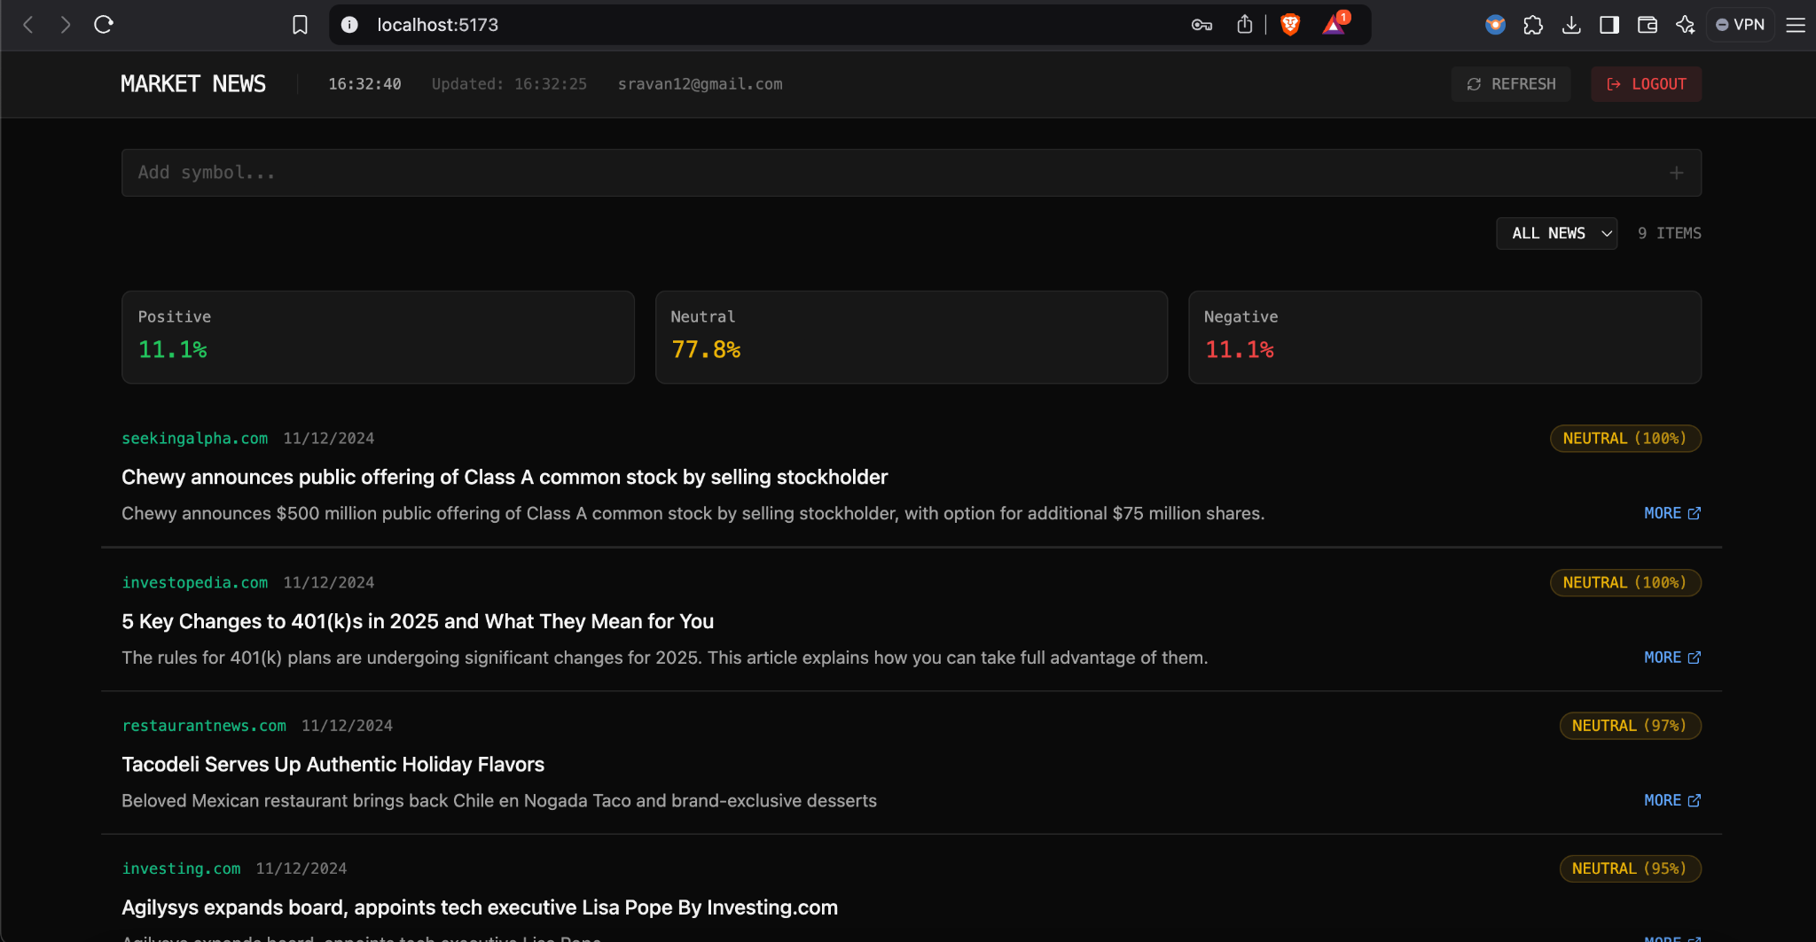
App Screenshot

Slide 42
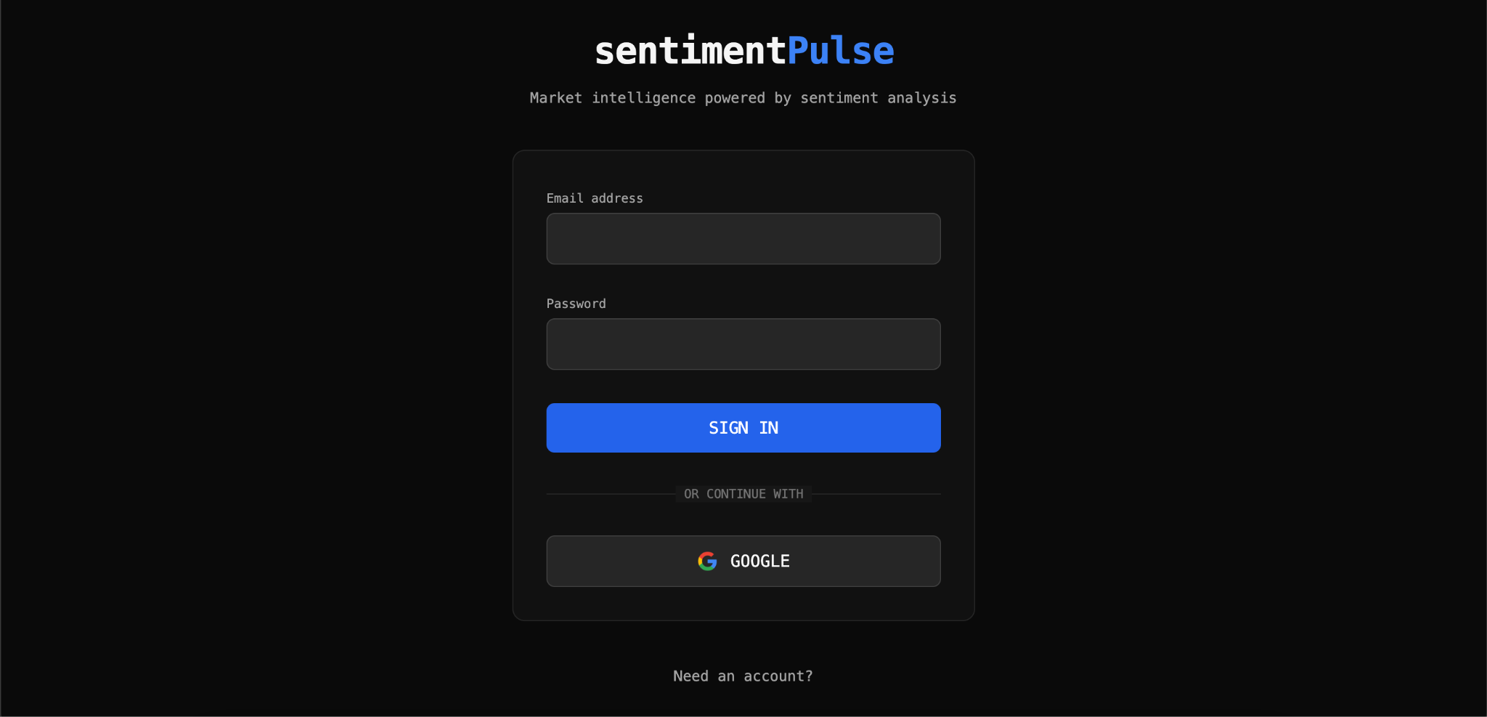
App Screenshot

Slide 43
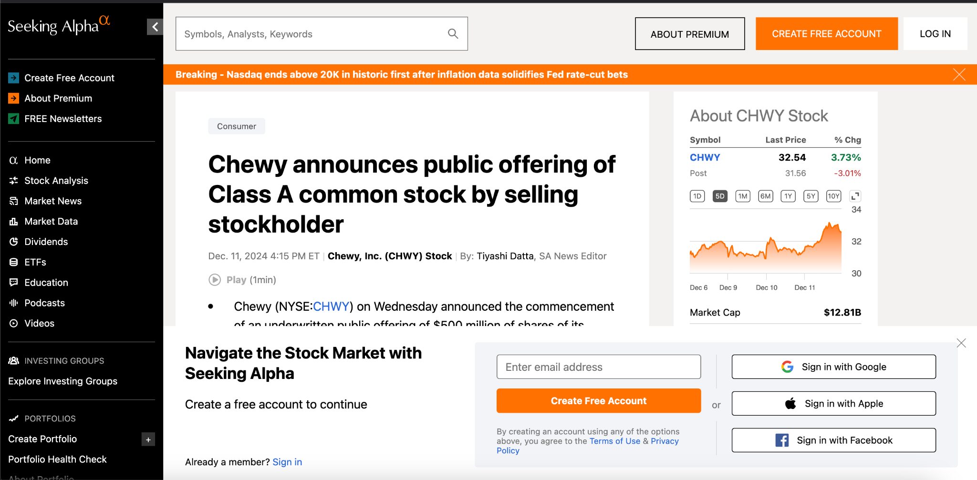
App Screenshot

Slide 44
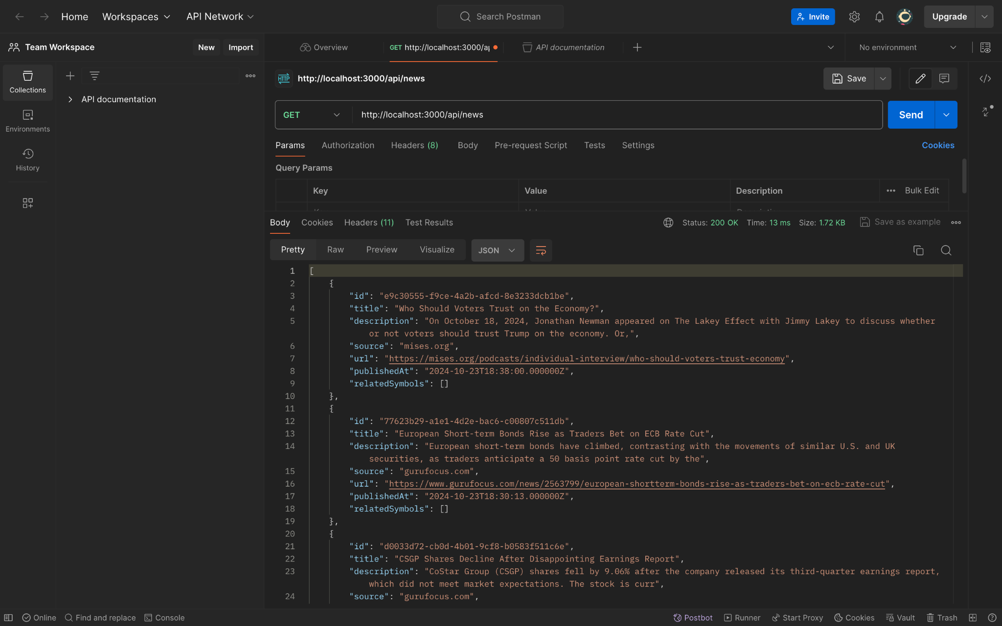
API

Slide 45
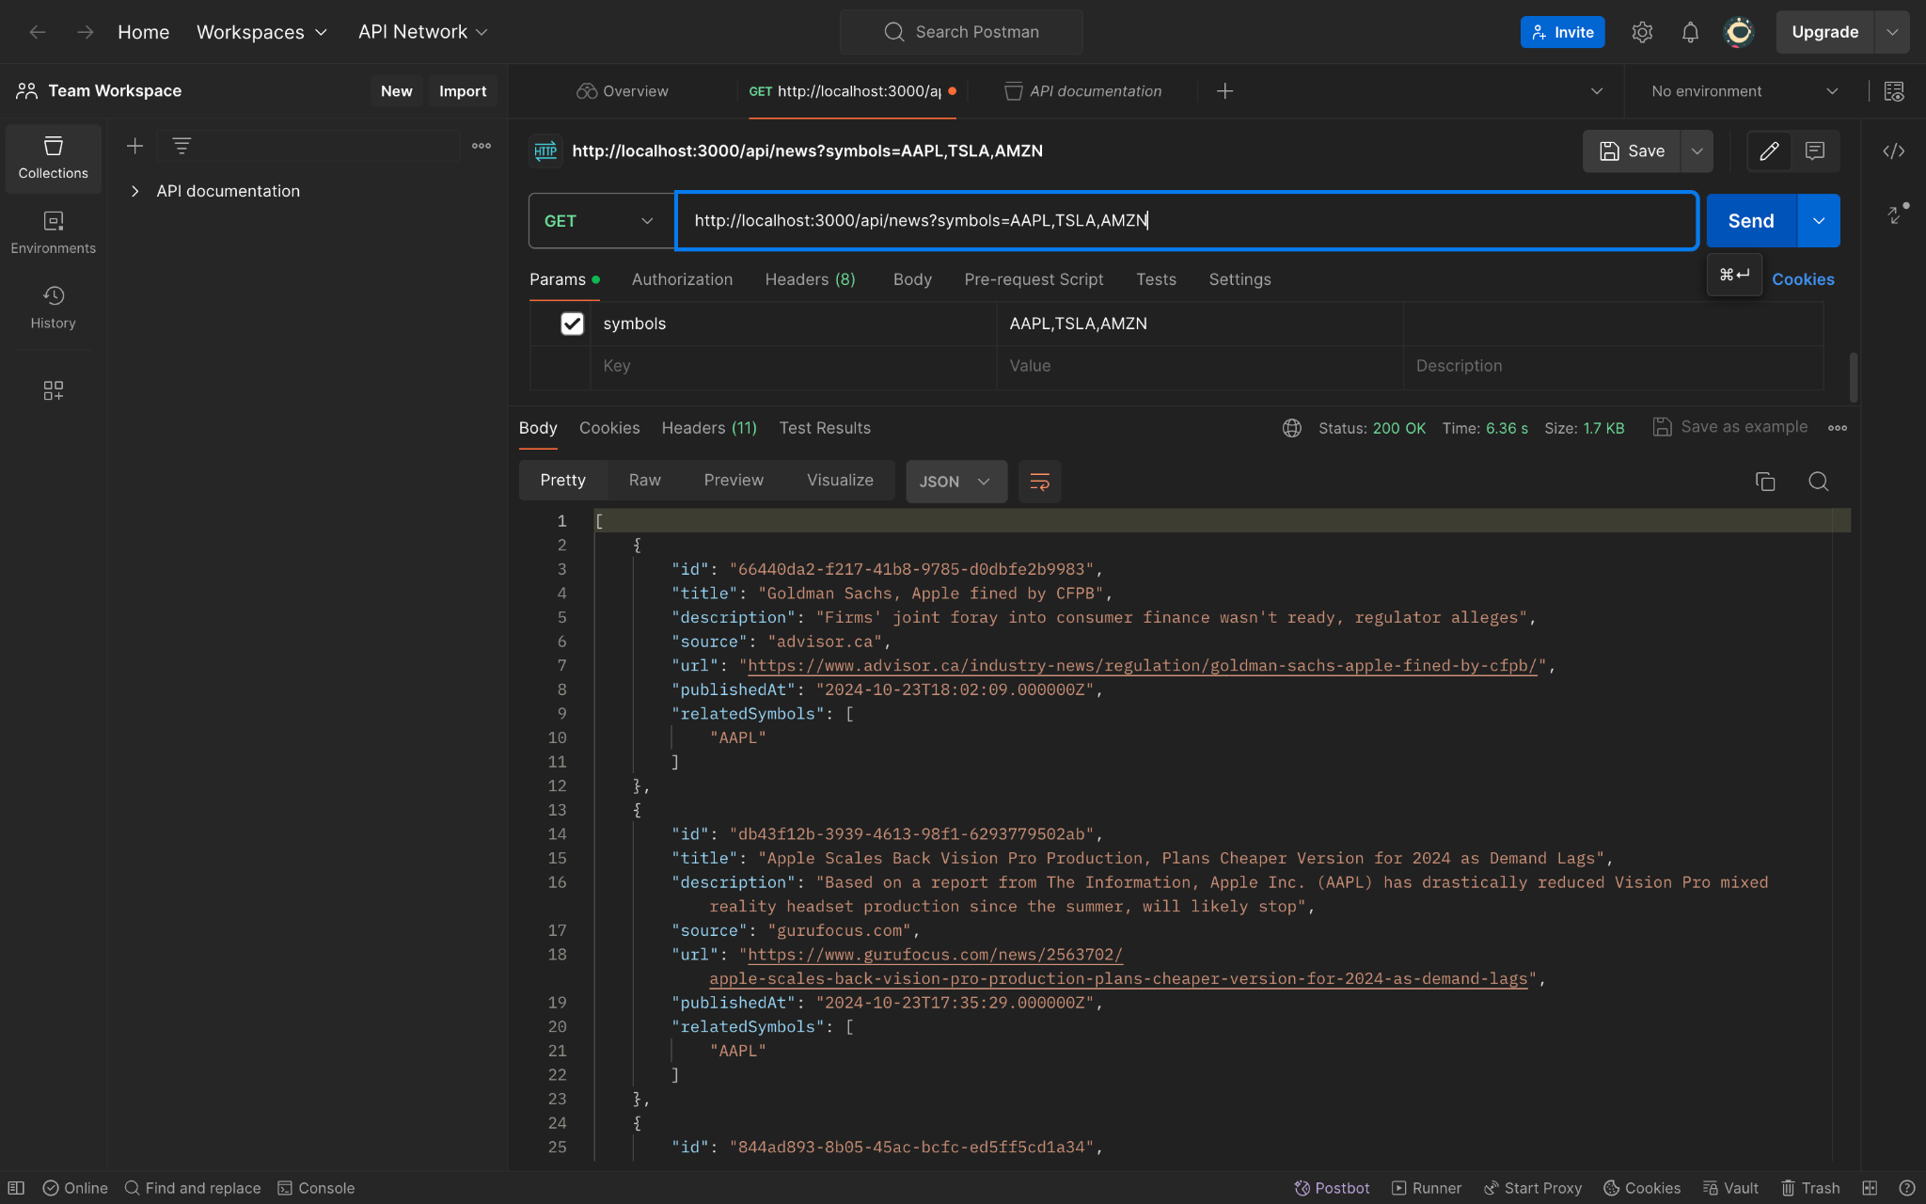
API

Slide 46
WikiPage
https://github.com/htmw/2024F-Team-Spirit/wiki

Slide 47
Application Demo
LIVE

Slide 48
Thank you

